Slide 1



Slide 2

TABLE OF CONTENTS
02
01
03
04
INTRODUCTION / DATA OVERVIEW
DATA VISUALIZATION
Data Description
Data Cleaning & Processing
Histogram & Boxplot
TABLEAU DASHBOARD
CONCLUSION
Dashboard
Conclusion

Slide 3

Problem Statement!
The overall problem statement appears to involve exploring various aspects of a car sales dataset,
Including sales distribution, brand popularity, feature distributions. The goal is to gain insights into customer preferences, sales patterns, and correlations
Analysis of Brands
- Declining Sales in Certain Dealer Regions
- Evaluation of different car brands
- Analysis of popular color choices
- Comparison of different car models

Slide 4

01
INTRODUCTION

Slide 5

DATA OVERVIEW
The dataset provides comprehensive details about car transactions, encompassing information on dealers, brands, and various attributes influencing the automotive market.
Key columns include 'Date', 'Gender', 'Annual Income’, 'Company', 'Model', 'Engine', 'Brand', 'Color', 'Price', 'Body Style', 'Dealer Region’
Data Cleaning & Processing Steps:
Handling Duplicates: Checked and removed duplicate entries using the duplicated method.
Missing Values: Addressed missing values using methods like forward fill, Fillna and dropping rows where necessary.
Data Types: Ensured correct data types for each column using the info method.
Descriptive Statistics: Utilized the describe method to generate descriptive statistics for numerical columns.
Data Visualization: Employed libraries such as NumPy, Pandas, Matplotlib, and Seaborn for data visualization, creating insightful plots and graphs.

Slide 6
03
DATA VISUALIZATION

Slide 7

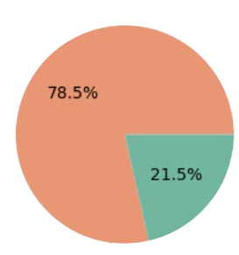
Gender Distribution Analysis:
GENDER
78.5%
Male
21.5%
The gender distribution in the car sales dataset indicates that approximately 78.5% of customers are male, while 21.5% are female. This observation suggests a notable predominance of male customers in car purchases, reflecting potential gender-specific preferences or market dynamics.
Female

Slide 8
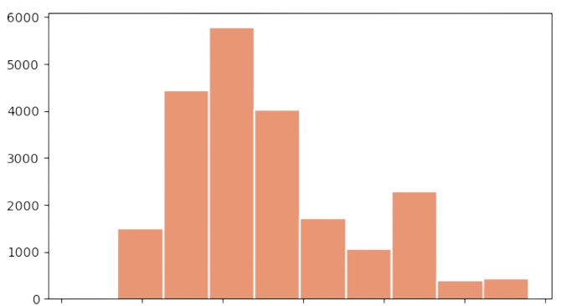
Distribution of cars based on their price range
The histogram plot indicates that a significant number of cars fall within the price range of 15000 to 20000, suggesting that this price bracket is popular among customers.
As the price increases beyond this range, there is a noticeable decline in the number of cars, indicating a potential correlation between price and demand.
10000
20000
30000
40000
50000
60000

Slide 9
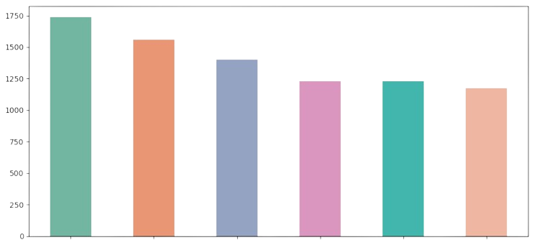
Which company has the highest sales?
The bar chart reveals that Chevrolet leads in car sales, closely followed by Dodge and Ford, while Jaguar and Saab exhibit comparatively lower sales. Understanding the sales performance of different companies provides valuable insights into market dynamics and consumer preferences. This information can guide strategic decisions and marketing efforts to further enhance the overall performance of the automotive business.
Chevrolet
Dodge
Ford
Volkswagen
Mitubishi
Marcedes-B

Slide 10
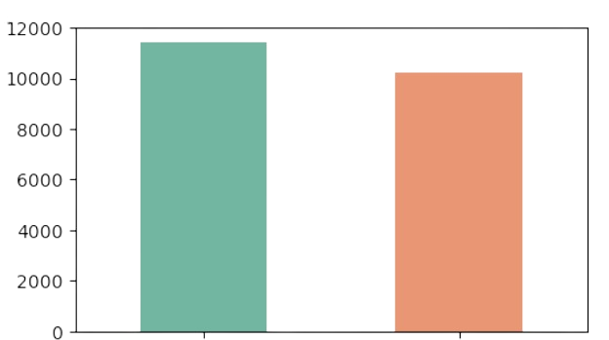
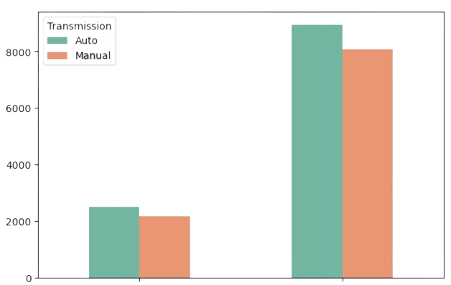
Distribution of different Transmission types
52.76%
47.24%
Auto
Manual
The bar chart illustrates that auto transmission constitutes 52.76%, while manual transmission comprises 47.24% of the dataset.
Additionally, the gender-related trend, indicating that the majority of customers, especially males, prefer a particular transmission type.
Female
Male

Slide 11
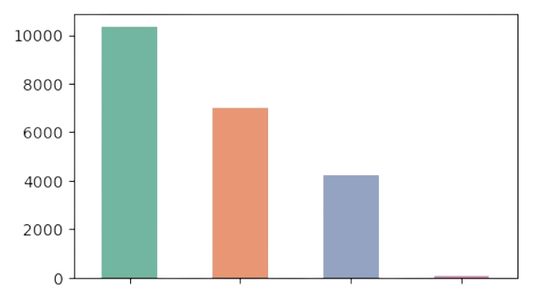
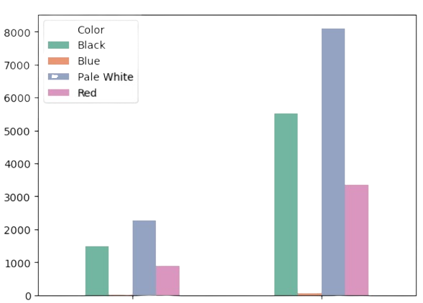
Popularity of different Car colors
10371
7007
4251
66
Pale White
Black
Red
Blue
47.81%
32.29%
19.56%
0.30%
Female
Male
The bar chart indicates that pale white is the most popular color, constituting 47.81% , followed by black at 32.29%. Red comprises 19.56%, and blue has a minimal presence at 0.30%.
This information is valuable for manufacturers and dealerships in aligning their inventory with customer preferences

Slide 12
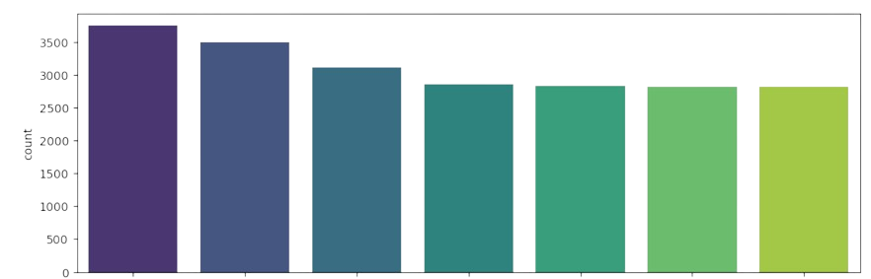
Which dealer regions have the highest count of car sales
Austin leads the sales count, followed by Janesville and Scottsdale, while Aurora has the least count.
This insight into regional sales distribution provides valuable information for dealerships and manufacturers in optimizing their strategies and focusing on regions with higher demand.
Austin
Pasco
Green Ville
Aurora
Janesville
Scottsdale
Middletown

Slide 13
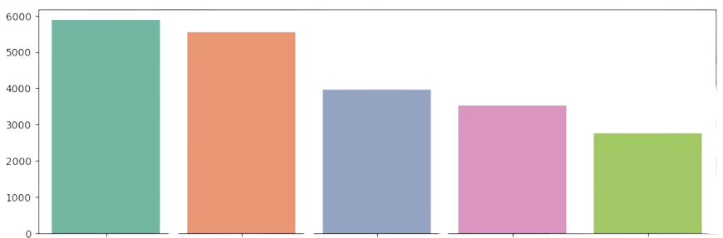
Preferred body styles of cars among customers
Here indicates that SUVs are the most preferred body style, followed by hatchbacks, sedans, passengers, and hardtops.
Understanding these preferences can guide manufacturers and dealerships in tailoring their offerings to align with customer choices.
SUV
Hatchback
Sedan
Passenger
Hardtop

Slide 14
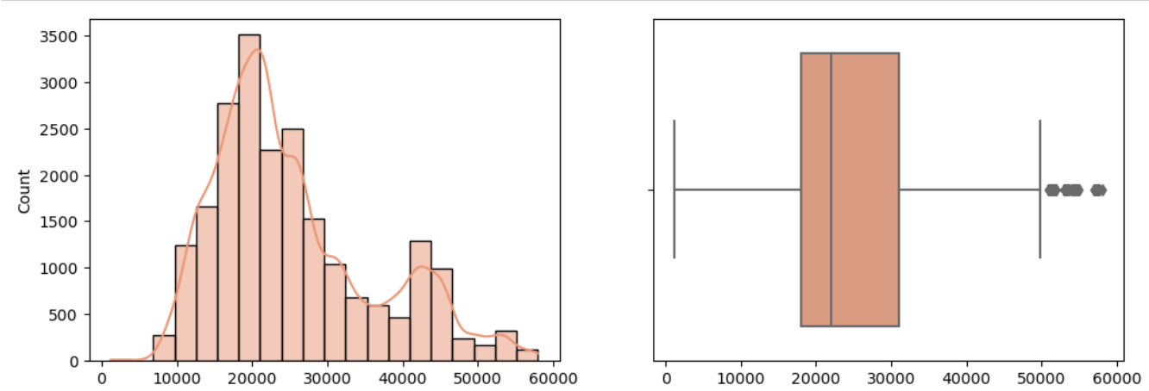
Distribution of preferred price ranges among customers
The distribution of preferred price ranges among customers, considering the average prices and visualizing it through histograms, KDE, and box plots, provides a comprehensive understanding of the dataset. The peak around $23,000

Slide 15
04
TABLEAU DASHBOARD

Slide 16
Problem Statement:
The dashboard will provide real-time insights into KPI’s related to our sales data. This will enable us to make informed decisions, monitor our progress and identify trends and opportunities of growth.
Sales Overview
YTD Sales weekly trend
Display a line chart illustrating the weekly trend of YTD sales.
YTD Total sales
YOY Growth in total sales
YTD total sales by car body style
Visualising the distrivution of YTD total sales across different car body styles using a pie chart
Average Price Analysis
YTD Average price
YOY Growth in average price
YTD total sales by color
Donut chart representing the total cars sold on various colors
YTD cars sold by dealer region
Car Sold Metrics
Showcasing the YTD sales based on different dealer region, using a bar chart.
YTD Cars Sold
YOY Growth in Cars Sold
Company wise sales trend in Grid form
A tabular grid to display the sales trend for each company.

Slide 17

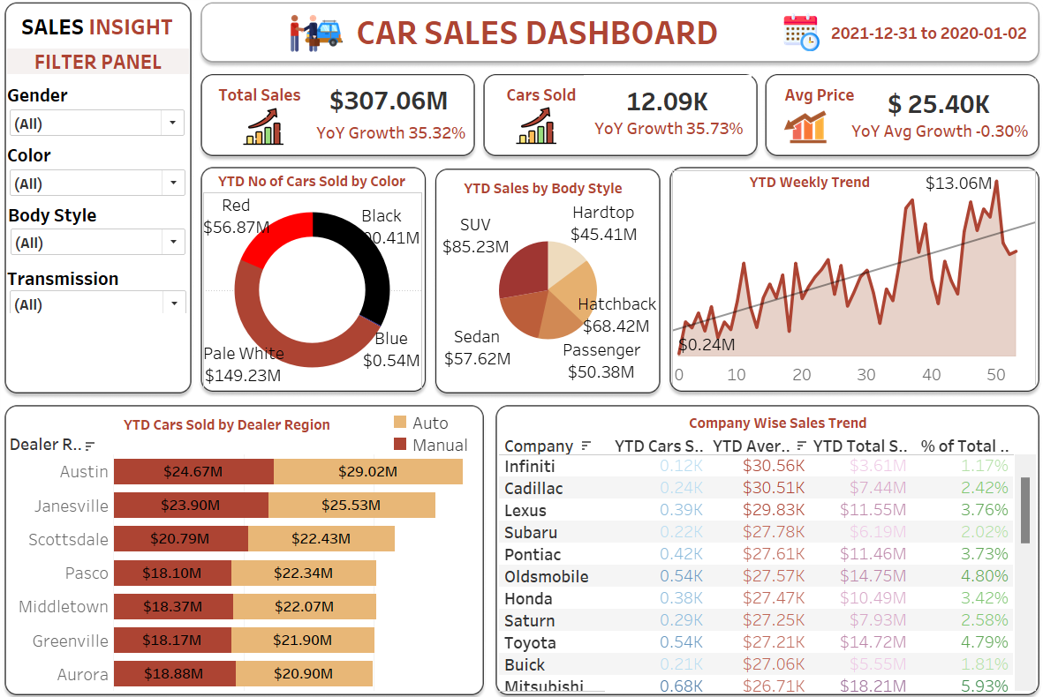
Year To Year Sales

Slide 18

Company Solutions
1
Declining Sales in Certain Dealer Regions
Implement targeted marketing strategies in regions with lower sales, offering promotions or exclusive deals to attract more customers
Low Sales for Specific Body Styles
2
Analyzing customer preferences & feedback to understand why certain body styles have lower sales. Introducing promotional or discounts for less popular styles
3
Limited Female Customer Engagement
Develop marketing campaigns specifically designed to attract female customers, events
Varied Price Preferences Among Customers
4
Implement dynamic pricing strategies or personalized offers based on customer profiles
Overrepresentation of Certain Car colour
Exploring options to diversify the color palette in your inventory. Consider customer surveys or trends in the automotive industry to identify popular and emerging color preferences
5

Slide 19

CONCLUSION
05

Slide 20
SALES AND DISTRIBUTION
Market Trends
The market trend suggests a preference for SUVs, with the majority of sales falling under this body style, followed by hatchbacks, sedans, passengers, and hardtops
Brand Performance
Chevrolet emerged as the top-selling brand, with strong sales figures, while Jaguar and Saab experienced lower sales.
Color Popularity
Pale white stands out as the most popular car color, attracting 47.81% of customers. Black and red also have significant shares, while blue remains less preferred.
Gender Influence
The dataset reflects a predominantly male customer base, indicating potential opportunities to engage and attract more female customers through targeted marketing and promotions

Slide 21
THANKS!
Do you have any questions?
arshonlyy@gmail.com
+91 8867 8484 50
NIIT
facebook.com/mirza-arshi-abbas
@arshiabbas50
Linkedin.com/in/arshiabbasmirza

